Slide 1
CSE7302 - INTERNSHIP Review-3 Presentation TITLE OF THE INTERNSHIP / WORK ASSIGNED / DOMAIN
Student Details
Name | VENKATA HEMANTH.N
Roll No | 20221CBD0007
Section | 08CBD-01
Under the Supervision of,
Ms. Thabassum Khan
Assistant Professor
Presidency School of CSE
Presidency University
Name of the Program: B.tech Computer Science and Technology (Big Data)
Name of the HoD: Dr. Pravinth Raja
Name of the Program Internship Coordinator: Ms. Nisha Robin Rohit
Name of the School Internship Coordinator: Dr. Md Ziaur Rahman

Slide 2
Content
About Company or Organization
Working domain or the technology
About your team and reporting Manager
Challenges Faced in Internship
Objectives of the work
Literature Review
Proposed System
Problem Statement
System Requirements
Advantages of Proposed System/Work
System Design
System Implementation
Internship Roadmap
Github Link

Slide 3
About Company or Organization
Rittal India Private Limited is a leading company that provides industrial and IT infrastructure solutions, specializing in enclosure systems, power distribution, thermal management, and data center solutions. It is a subsidiary of Rittal GmbH & Co. KG, Germany, part of the Friedhelm Loh Group.
Subsidiary of Rittal GmbH & Co. KG, Germany
Established in India in 1996
Provides industrial and IT infrastructure solutions
Major products include enclosures, cooling systems, power distribution, and IT infrastructure

Slide 4
Working domain or the technology
Domain: Research & Development (R&D)
Role: Embedded Software Developer Intern
Working as a Software Developer Intern in the R&D (Embedded Systems) domain
Currently in the office I am developing web Application .
On the process of connecting the Application to backend Database.
Gaining knowledge of full stack development .

Slide 5
About your team and reporting Manager
Team Size: 1 member
Team Composition: Research & Development (R&D) undergoing training in : Embedded Software Developer Intern
Current Activity:
Learning how to develop web Application using HTML5, CSS and JAVASCRIPT for frontend. Learning how REST API works . Learning how to create json format database file.
Reporting: Guided by an Internship Mentor for progress reviews and learning assessments

Slide 6
Challenges Faced in Internship
Understanding the existing project structure and code initially took time.
Connecting the frontend dashboard with the backend server was challenging at first.
Debugging errors in the program required careful testing and troubleshooting.
Implementing sensor data logging in Excel needed learning new libraries.
Designing a clear and user-friendly dashboard interface was difficult initially.
Managing time while learning new technologies and completing tasks was challenging.

Slide 7
Objectives of the work
To gain practical exposure to industrial technologies and R&D activities
To support ongoing work through documentation, analysis, and learning-based contributions
To develop technical, organizational, and professional skills

Slide 8
Literature Review
Many industrial systems use sensors to monitor parameters like temperature, pressure, and flow in real time.
Modern monitoring systems use IoT and web technologies to collect and display sensor data.
Web-based dashboards allow users to monitor systems remotely and easily detect faults.
Data logging systems store sensor data for analysis and troubleshooting.
These studies helped in developing the Sensor Monitoring System for real-time monitoring and system status analysis.

Slide 9
Proposed System / Work
The proposed system is a web-based sensor monitoring system that displays real-time sensor data.
It monitors different sensors such as temperature, pressure, flow, pump, valve, and leak detection.
The system provides a dashboard interface to view the overall system status.
Alarm detection is implemented to alert users when sensor values exceed the set limits.
Sensor data is logged and stored in Excel files for future analysis.
The system allows users to configure sensor ranges and monitor system performance easily.

Slide 10
Problem Statement
Industrial systems require continuous monitoring of sensors to ensure safe and efficient operation.
Manual monitoring of sensor values is difficult and may lead to delayed fault detection.
Lack of a centralized system makes it hard to track multiple sensor readings at the same time.
Without proper monitoring, abnormal conditions like high temperature or pressure may damage equipment.
There is a need for a system that can monitor sensor data in real time and detect alarms automatically.
Therefore, a web-based sensor monitoring system is required to improve monitoring and system safety.

Slide 11
System Requirements
A computer system with a web browser to access the monitoring dashboard.
Node.js environment to run the backend server.
Internet or local network connection for communication between frontend and backend.
Software tools such as VS Code for developing and editing the project.
Libraries such as Express.js and XLSX for server operations and data logging.
Storage to save sensor data logs and configuration files.

Slide 12
Advantages of Proposed System/Work
Provides real-time monitoring of sensor values.
Helps in early detection of system faults and alarms.
Stores sensor data in Excel for analysis and record keeping.
Allows easy monitoring through a web-based dashboard.
Improves system safety and efficiency by tracking multiple sensors at once.

Slide 13
System Design
The system is designed as a web-based application for monitoring sensor data.
It follows a client-server architecture with frontend and backend components.
The frontend dashboard displays sensor values and system status.
The backend server processes sensor data and checks alarm conditions.
Sensor data is stored in Excel files for logging and analysis.

Slide 14
System Implementation (At least 50%)
The frontend application for the Sensor Monitoring System has been successfully developed.
The user interface includes pages such as dashboard, sensor monitoring, troubleshooting, and configuration.
The frontend is designed using HTML, CSS, and JavaScript for displaying system information clearly.
The application can display sensor status and system monitoring information through the dashboard.
The system is currently in the process of connecting the frontend application to the backend database/server.
Once integration is completed, the system will be able to store and retrieve sensor data for monitoring and analysis.

Slide 15
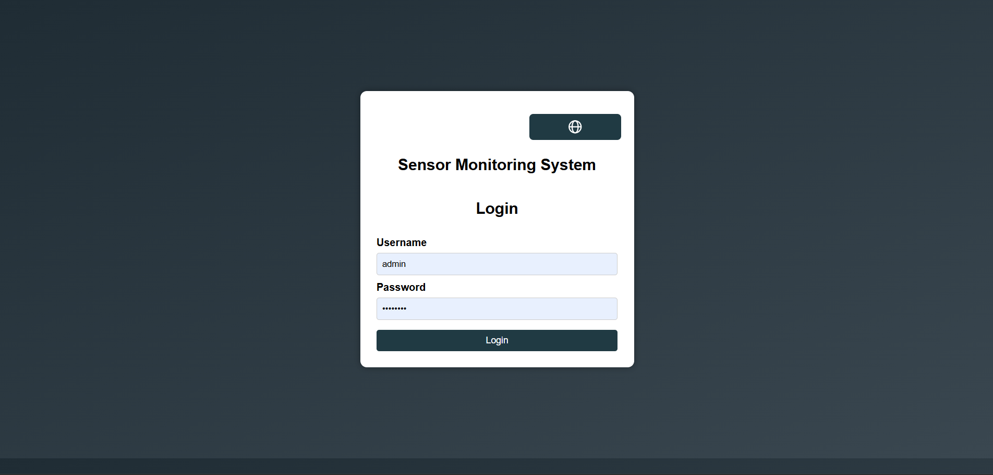

Slide 16
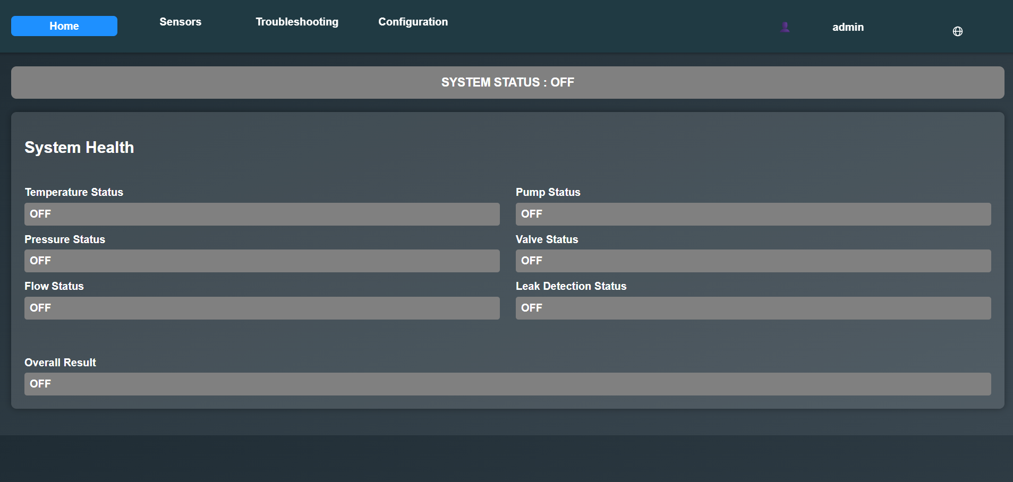

Slide 17
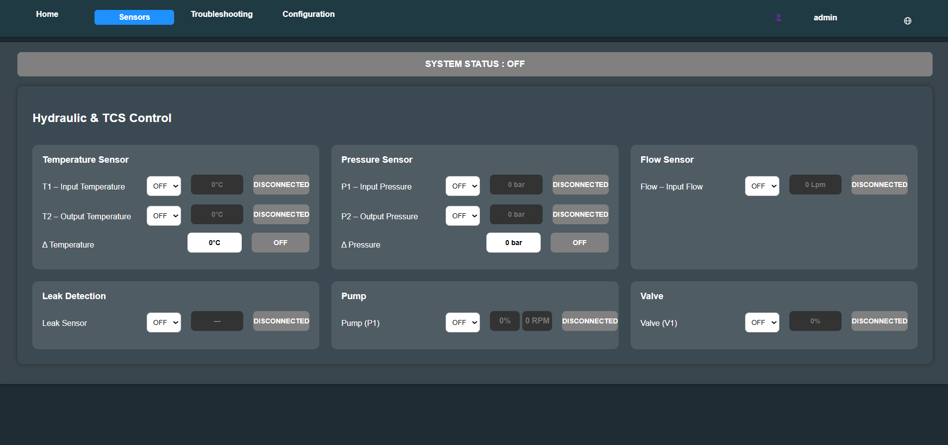

Slide 18
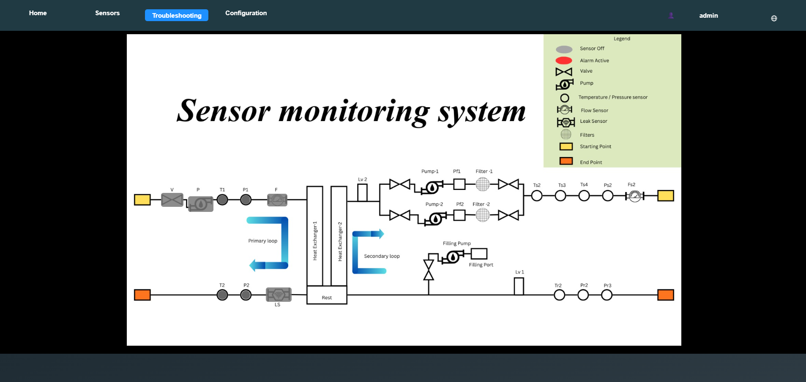

Slide 19
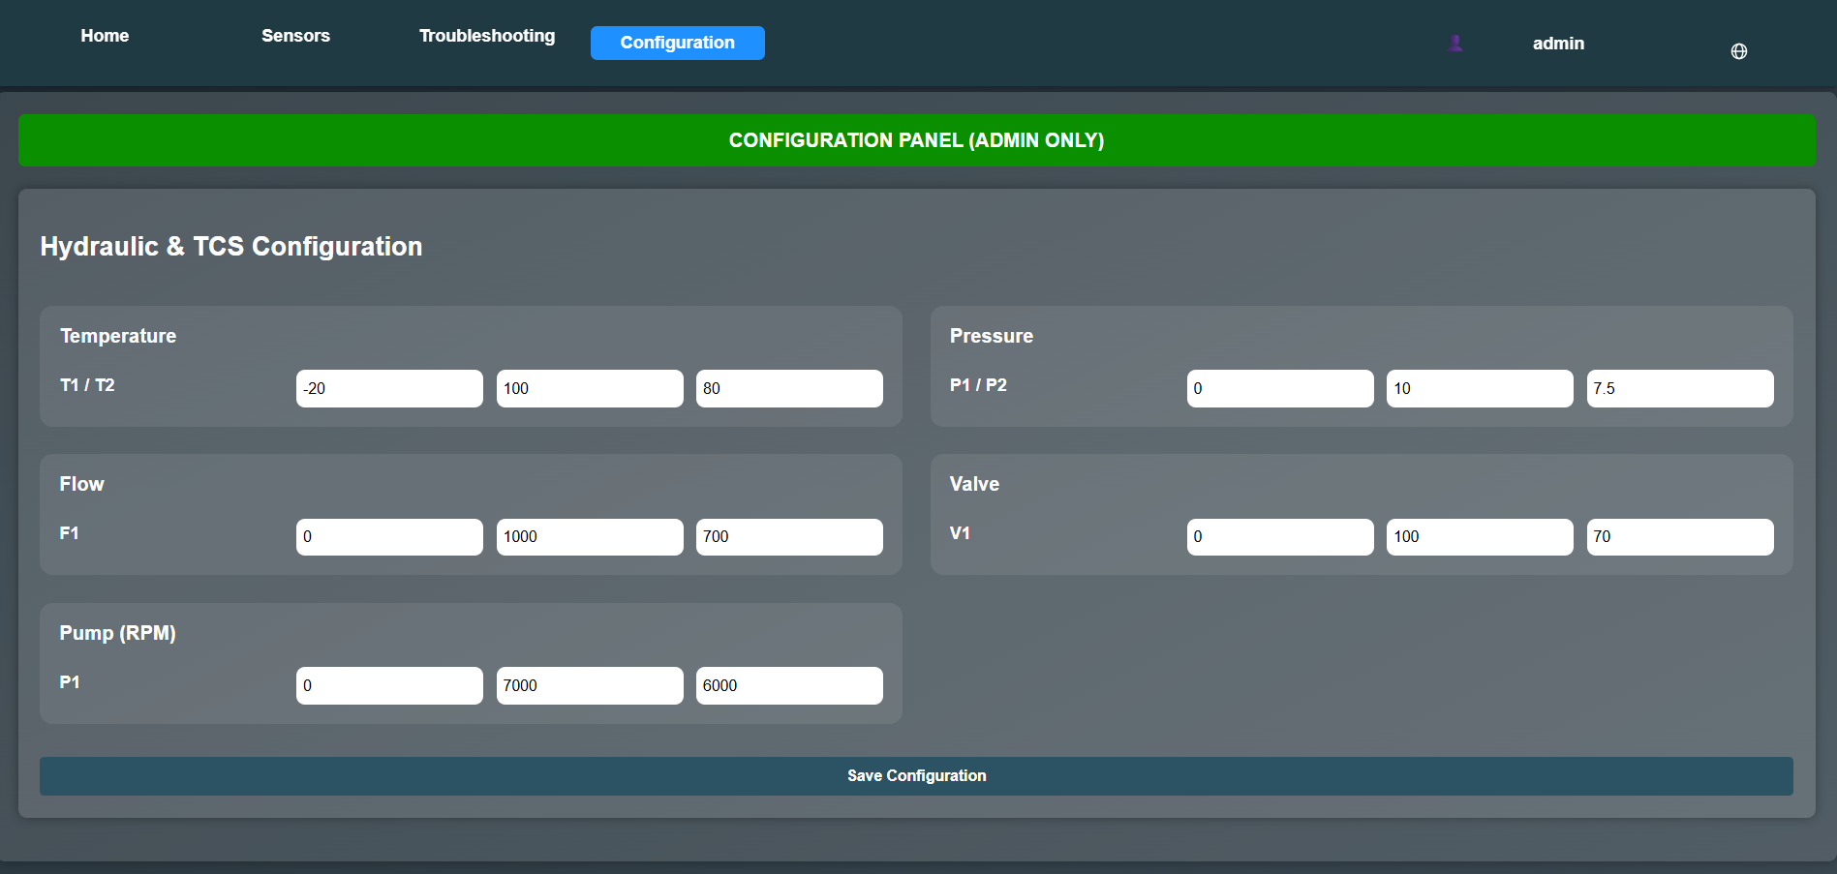

Slide 20
Internship Road Map
Note: Write in the below table what u will be achieving in each review
Review 1
On
boarding
Review 2
Training
Review 3
Skill Building
Review 4
Application
Final Review
Completion
And Certificate

Slide 21
Github Link
https://github.com/naralahemanthreddy-hue/Intenship

Slide 22
Q&A

Slide 23
Thank you !!

